Slide 1
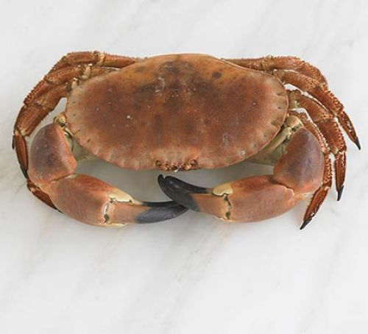
How poems work: Strayed Crab
Name of student
University

Slide 2

Agenda
1. biographical background of the author
2. Discussion of the main Idea/Theme
3. Evidence supporting the main idea
4. Two different pieces of evidence/literary devices
5. Fielding question about the poem
6. Conclusion

Slide 3
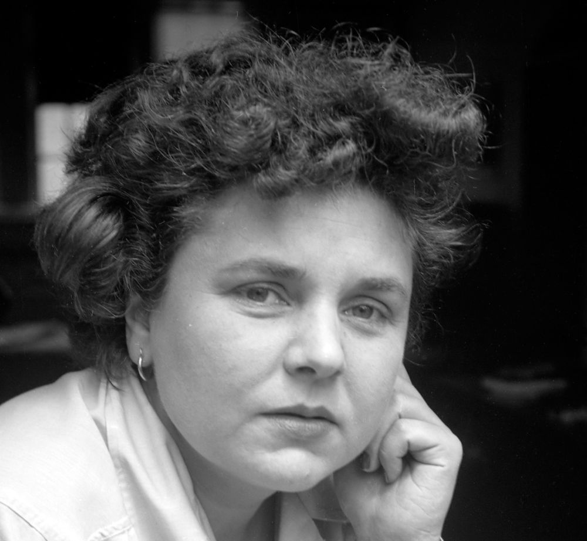
1. biographical background of the author
Born in Worcester, Massachusetts in 1991,Elizabeth Bishop was an influential person in American literature.
She chose a writing style whereby she took her time in refining her existing works rather than writing many literary work.

Slide 4

2. Discussion of the main Idea/Theme
The Nature
The main theme of the poem revolves around nature and its beauty.
The poet describes the delicate attraction by the crab.
The author vividly describes the color of the crab’s yellow claws revealing the inner beauty of the crab.

Slide 5
Evidence supporting the main idea
Nature and beauty theme is supported by various pieces of evidence.
For instance, the author describes the encounter of the snail and crab.
The poet goes further to show the intention of the crab to harm the snail.

Slide 6
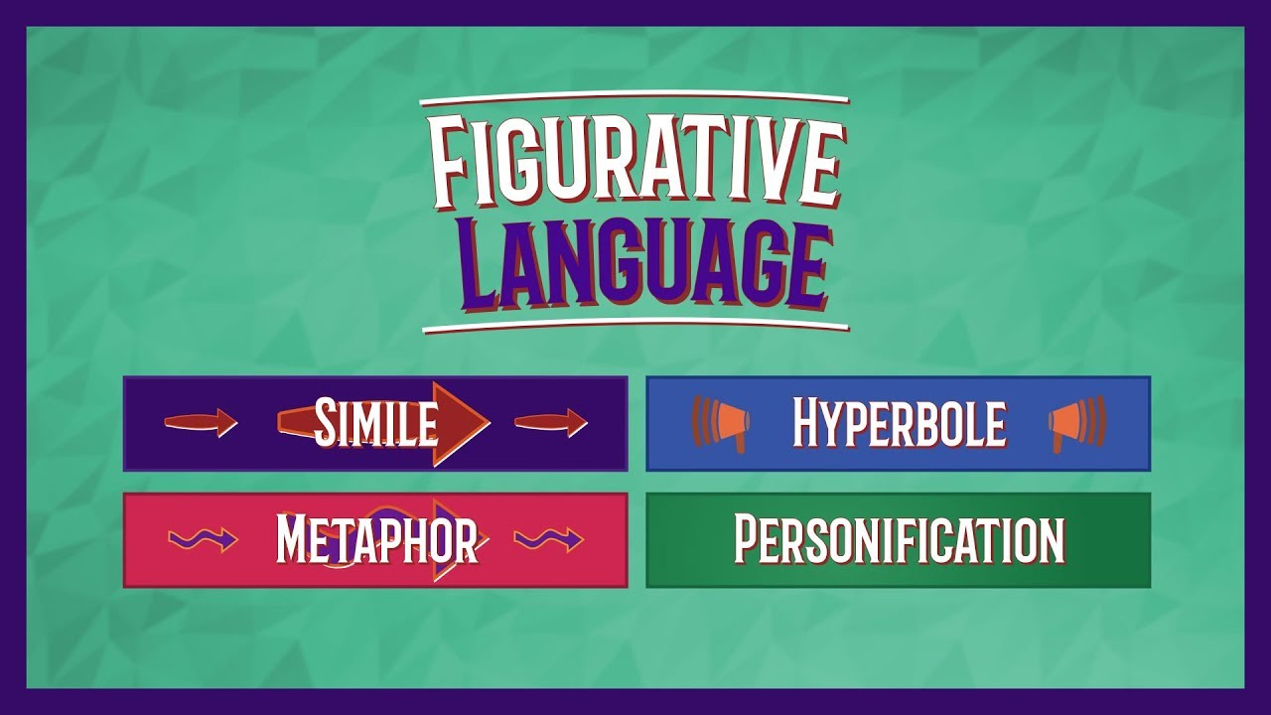
Two different pieces of evidence/literary devices
Figurative language
Metaphor- she makes direct comparison of two different ideas or objects and considers the common things they share
Simile- she uses figures of speech such as like, and as to bring comparison between two thing of different kinds

Slide 7

Conclusion
Bishop has made a comparison between herself and the crab and made similarities.
She considers the voice of the crab to bring a sharp distinction between excessive and proper.
The relationship between the author and the crab expresses the nature in the world we live in and the creatures around us.

